Slide 1


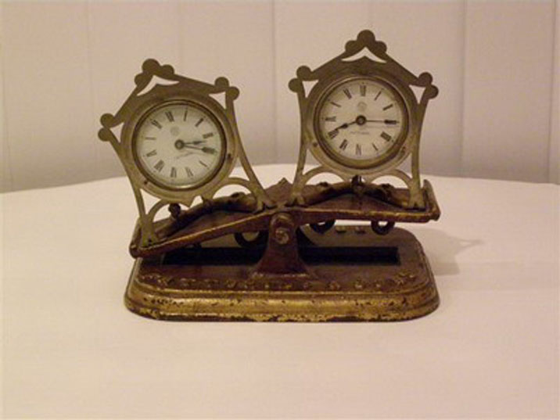
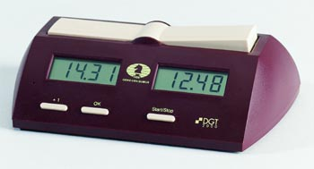
CHessclocks
ECF ARBITER SEMINAR

Slide 2
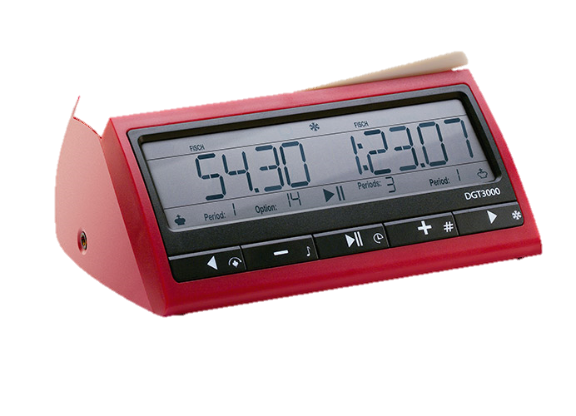
Chessclock
Chessclock – a clock with two time displays connected to each other. Only one display can be active at any time.
Clock – one of the two time displays.
The display should show the time available for the player
The display should be visible from a distance of 3 metres
The player should be able to tell which clock is running from 10 metres
A sign on the display (flag) must indicate which player passed the time control first

Slide 3

Chessclock
For battery powered clocks a low battery indication is required. This must give at least 10 hours warning
The clock should not add any incremental times if a player has exceeded the final time control
The arbiter should be able to add penalties within 60 seconds
It should be impossible for a player to change or delete the display with a simple manipulation
There should be a short manual with the clock
The same type of clock should be used throughout a tournament

Slide 4
Chessclock
A move is only completed when the clock is pressed. (This may complete more than one move.)
A player must always be allowed to stop his clock after moving.
If the last move of a time control is made but not completed by pressing the clock and the flag falls then the player loses unless the opponent cannot deliver mate.
The clock must be pressed with the same hand as made the move.
If a player cannot press his clock then the Laws provided for this. In the case of a disability no penalty should apply. If for other reasons (possibly religious) time should be deducted from the players clock.

Slide 5
Setting clocks
An arbiter should know how to set a clock before a tournament begins.
The arbiter should also be aware of any limitations on the clock. e.g. a DGT Easy does not allow increments, a DGTEasy Plus only allows one session to be set. Some clocks do not allow 2 minute penalties to be set accurately.
For a review of clocks and videos on how to set them visit the clock webpage of the Chess Arbiters’ Association.
www.chessarbitersassociation.co.uk

Slide 6
Chessclock
Players should not hit the clock too hard.
The arbiter has the right to say where clocks are placed.
A flag is considered to have fallen only when observed by a player or the arbiter.
If a faulty clock has to be replaced the arbiter shall use best judgement as to how it shall be set.
If the position has to be reset the arbiter shall also use best judgement. This might mean leaving the clocks as they were if the schedule would be disrupted.

Slide 7
Chessclock
If both flags have fallen and it cannot be established which fell first then the game shall continue unless it is the final session.
If the former the next move will be the first of the new time control (unless it can be proved more moves have been played than required for the previous session.)
If the final session then the game is drawn.
Digital clocks indicate which flag fell first – this evidence can be used. (This has been removed to the Guidelines but should still apply.)

Slide 8
Chessclock
A player may stop the clock if they have a valid reason.
A player who stops the clock without a valid reason may be penalised.
If the clocks are stopped it is the arbiter who decides when a game restarts.

