Slide 1

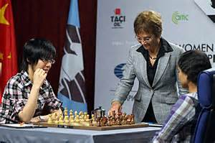
Duties of An Arbiter

Slide 2
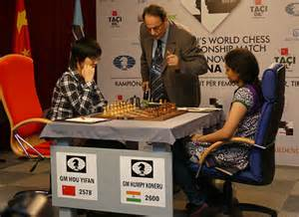
Duties of an Arbiter
The first duty of an arbiter is to look after the players. This is done by:
Ensuring fair play
Making sure players are not disturbed
Reporting/recording results accurately
Punctuality
How to be a good Arbiter

Slide 3
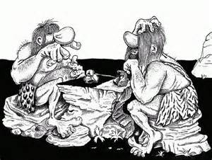
Duties of an Arbiter
Ensuring fair play
Make sure Laws are followed
Avoid cheating by players
Observe games particularly if a player is short of time
How to be a good Arbiter

Slide 4
Duties of an Arbiter
Making sure players are not disturbed
Prevent noise
Ensure best playing conditions – space, heating, lighting
The ‘invisible’ arbiter e.g. new scoresheets
How to be a good Arbiter

Slide 5
Duties of an Arbiter
Reporting/recording results accurately
Check results when they come in – do both players agree
Check results are entered correctly
Ensure results are passed on for rating
Ensure prize lists are accurate
How to be a good Arbiter

Slide 6
Duties of an Arbiter
Punctuality
Arrive in time to
Set clocks and boards
Put out scoresheets
Display pairings
Be available when
Players are likely to be in time trouble
Draws, etc. need to be done
Continuation scoresheets are needed
Don’t disappear before your work is finished
How to be a good Arbiter

Slide 7
Duties of an Arbiter
Show respect to players, spectators, etc.
Observe games
Be responsible
Help colleagues
Know the regulations
Follow a dress code
Stay calm – or at least appear to do so.
How to be a good Arbiter

Slide 8
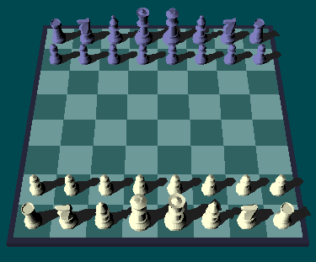
Duties of an Arbiter
Before the Start of a Game
Arrive early at least 30 minutes before the start of a round (1st round even earlier)
Check playing venue and conditions
Check equipment
Check layout
Check namecards etc./players are in correct place/order
General Duties

Slide 9
Duties of an Arbiter
During the Game
Check player arrival (zero default especially)
Carry out regular clock checks
Patrol your area
Check any claims received from players
Check correct result handed in
Update results sheet, etc.
General Duties

Slide 10

Duties of an Arbiter
After the Round
Check results/scoresheets – match totals if appropriate
Pass on any information required to appropriate person
Reset boards, clocks etc
General ‘tidy-up’
General Duties

Slide 11
Duties of an Arbiter
There are two Arbiting titles awarded by FIDE
There is the FIDE Arbiter Title (FA) and there is the International Arbiter title (IA). You must gain the FA title before progressing to the IA title.
There are also Categories of Arbiter within these titles.
Arbiting Titles

Slide 12
Duties of an Arbiter
Thorough knowledge of the Laws of Chess, FIDE Regulations for competitions and Swiss Pairing Systems.
Absolute objectivity
Sufficient knowledge of at least one FIDE language
Ability to handle electronic clocks
Experience as Chief or Deputy Arbiter at 3 FIDE rated events
Passing a FIDE Arbiter Seminar
Requirements for the FA title

Slide 13
Duties of an Arbiter
Norms can be obtained as follows:
10 player APA/6 player double round APA FIDE rated (max 2)
20 player Swiss FIDE rated (max 2 unless one has over 100 players and 7 rounds)
Arbiter Exam (1 norm)
IBCA, ICCD (formerly ICSC), IPCA Arbiter (1 norm each)
Chief or Deputy at 9 round + 30 player Rated Rapid or Blitz (1 norm)
Four norms are needed within a six year period.
Applicants from federations unable to organise suitable tournaments may get title on passing exam.
Candidates must be aged 21 to obtain title.
Requirements for the FA title

Slide 14
Duties of an Arbiter
Knowledge of Laws, FIDE Regulations for competitions, Swiss Pairings, Regulations regarding achievement of title norms and rating system.
Objectivity
Conversational English and chess terms in other FIDE Languages
Knowledge of Pairing Programs endorsed by FIDE, Word, Excel and Email
Ability to use digital clocks
Requirements for the IA title

Slide 15
Duties of an Arbiter
Experience as arbiter in at least four FIDE rated events such as the following:
a) The final of the National Individual (adult) Championship (maximum two norms).
b) All official FIDE tournaments and matches.
c) International tournaments where FIDE title norms for players are possible. (at least 2 other nations)
d) International FIDE rated chess events with at least 100 players, at least 30% FIDE rated players, and at least seven rounds (maximum one norm).
e) All official World and Continental Rapid and Blitz Championships for adult and juniors (maximum one (1) norm).
Requirements for the IA title

Slide 16
Duties of an Arbiter
The title of the International Arbiter for each of the IBCA, ICSC, IPCA shall each be equivalent to one IA norm.
Being a match arbiter in an Olympiad is equivalent to one IA norm. No more than one such norm will be considered for the title.
The title of International Arbiter can be awarded only to applicants who have already been awarded the title of FIDE Arbiter.
All the norms for the IA title must be different from the norms already used for the FA title and must have been achieved after the FA title has been awarded.
At least two (2) of the submitted norms shall be signed by different Chief Arbiters.
Requirements for the IA title

Slide 17
Duties of an Arbiter
A titled active Arbiter (International Arbiter or FIDE Arbiter) and arbiters of national levels working in a FIDE rated tournament shall be charged with a “licence fee”.
The licence will be valid for life, on the condition the arbiter remains an active arbiter, and will be in effect from the day after FIDE has received the fee. Arbiters who have not done an appropriate event for two years are classified inactive.
The licence fee for arbiters of national levels is valid for life.
If an arbiter of national level is awarded the title of “FIDE Arbiter” the licence fee for this title has to be paid to FIDE.
If an arbiter upgrades his/her category only the difference between the category fee has to be paid to FIDE.
If a “FIDE Arbiter” achieves the title of “International Arbiter”, the fee for the new title has to be paid to FIDE.
Arbiter’s Licence

Slide 18
Duties of an Arbiter
The licence fee is: a) for A’ Category Arbiters (only IAs): |  | 300 €
b) for B’ Category Arbiters (only IAs): |  | 200 €
c) for C’ Category Arbiters: | IAs | 160 €
 | FAs | 120 €
d) for D’ Category Arbiters: | IAs | 100 €
 | FAs | 80 €
e) for Arbiters of National Levels (NA): |  | 20 €
Arbiter’s Licence

Slide 19
Duties of an Arbiter
Category A requirements (IA only) They have been Active International Arbiters during the last five (5) years. They have shown excellent knowledge of the Laws of Chess and the Tournament Regulations and no punishments have been imposed to them during their activities as Arbiters. They have acted as Chief Arbiter or Deputy Chief Arbiter: a) in at least one (1) major World event (Olympiad, World Individual Championship tournaments and matches, for Men and Women, World Cup, World Team Championships for Men and Women, World Youth, Cadets and Junior Championships) in the period of the last five (5) years, or b) in at least five (5) of the events mentioned in 3.3.3. (with at least two different types of tournaments).
Arbiter’s Licence

Slide 20
Duties of an Arbiter
Category B requirements (IA only) They have been Active International Arbiters during the last five (5) years. They have shown excellent knowledge of the Laws of Chess and the Tournament Regulations and no punishments have been imposed to them during their activities as Arbiters. They have acted in a period of the last five (5) years as Chief Arbiter or Deputy Chief Arbiter in at least two (2) of the following: a. the major Continental events such as Continental Individual Championship tournaments for Men and Women, Continental Team Championships for Men and Women, Continental Youth and Junior Championships, Continental Club Cup Tournaments; b. all the other World events included in the FIDE Calendar; c. Round Robin Tournaments with at least ten (10) participants (6 in a Double Round Robin), with an average rating above 2600 (2400 for a women only event). They have acted as Chief Arbiter or Deputy Chief Arbiter in at least five (5) of the events mentioned in 3.4.3 (with at least two different types of tournaments) in the period of the last five (5) years.
Arbiter’s Licence

Slide 21
Duties of an Arbiter
Category C requirements (IA or FA) They have been Active International or FIDE Arbiters during the last five (5) years. They have shown excellent knowledge of the Laws of Chess and the Tournament Regulations and no punishments have been imposed to them during their activities as an Arbiter. 3.4.3 They have acted in the period of the last five (5) years as Chief Arbiter or Deputy Chief Arbiter in at least two (2) of the following: a. all the other Continental events included in the FIDE Calendar b. Team Tournaments or Swiss System Tournaments with more than 150 c. Sector arbiter in World Youth or World Schools Individual d. Arbiter at Candidates, World Cup, World Team or Grand Prix Category D - All others
Arbiter’s Licence

Slide 22
Arbiter Title Application
Application Procedure – Required Forms
IT3 – Tournament Report Form with Cross Table and decisions on appeals
IA1 or FA1 – Arbiter Norm Report Form
IA2 or FA2 – Arbiter Title Application Form
All norms must be achieved within 6 years.
They are submitted by your national federation.
Application together with details is posted on FIDE website for a minimum of 60 days prior to finalisation.

