Slide 1

FIDE ARBITER COURSE
Laws of Chess

Slide 2
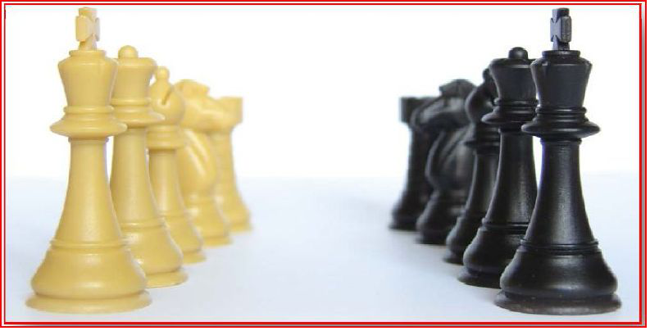
FIDE Laws of Chess (2018)

Slide 3

The Laws of Chess is divided into four sections.
Basic Rules of Play – information on how to set up the board, how the pieces move and how to finish a game
Tournament Rules – information on how to use a chessclock, how to deal with irregularities, the conduct of the players and the role of the arbiter.
Appendices – Additional info on Rapidplay, Blitz, Notation
Guidelines - Adjourned games, Blind players, Quickplay finishes and Chess960 (Fischer Random).

Slide 4
PREFACE
The Laws of Chess cannot cover all possible situations that may arise during a game, nor can they regulate all administrative questions. Where cases are not precisely regulated by an Article of the Laws, it should be possible to reach a correct decision by studying analogous situations which are regulated in the Laws. The Laws assume that arbiters have the necessary competence, sound judgement and absolute objectivity. Too detailed a rule might deprive the arbiter of his freedom of judgement and thus prevent him from finding a solution to a problem dictated by fairness, logic and special factors. FIDE appeals to all chess players and federations to accept this view.

Slide 5
A necessary condition for a game to be rated by FIDE is that it shall be played according to the FIDE Laws of Chess.
It is recommended that competitive games not rated by FIDE be played according to the FIDE Laws of Chess.
Member federations may ask FIDE to give a ruling on matters relating to the Laws of Chess.

Slide 6
BASIC RULES OF PLAY
Article 1: The nature and objectives of the game of chess
Article 2: The initial position of the pieces on the chessboard
Article 3: The moves of the pieces
Article 4: The act of moving the pieces
Article 5: The completion of the game

Slide 7
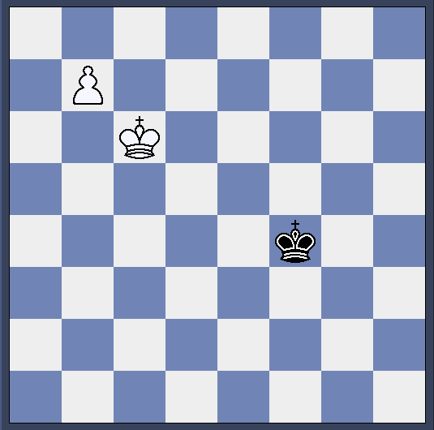
PROMOTION
4.6 The act of promotion may be performed in various ways:
1. the pawn does not have to be placed on the square of arrival,
2. removing the pawn and putting the new piece on the square of arrival may occur

Slide 8
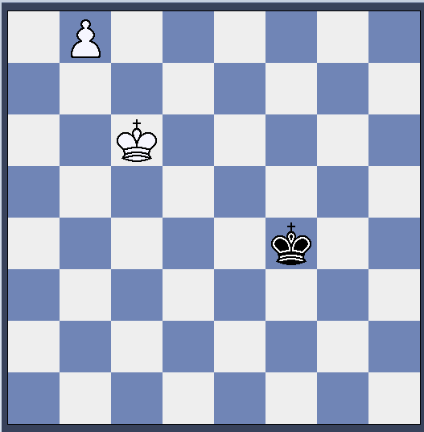
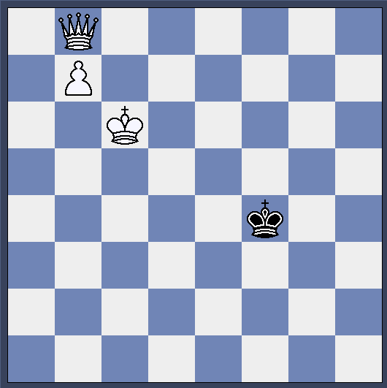
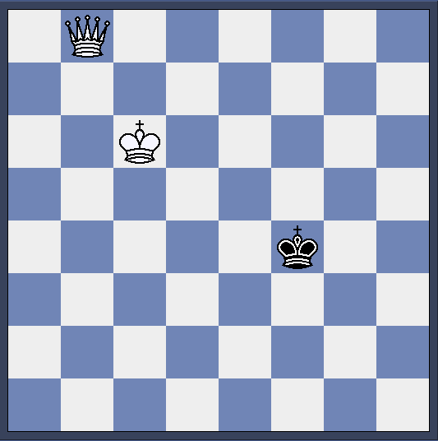
PROMOTION

Slide 9
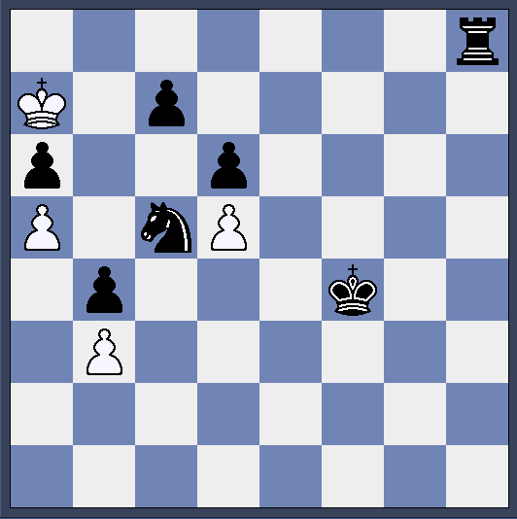
Drawn Position
With White to play it is stalemate.
This is a draw.

Slide 10
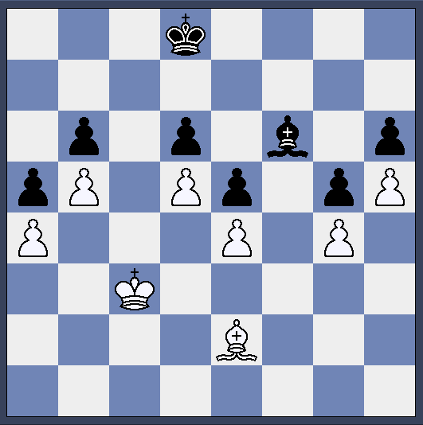
Drawn Position
This position is blocked.
It is a draw

Slide 11
Drawn Position
Insufficient mating Material
The following should be awarded as a draw automatically
K v K & B
K v K & N
K & B v K & B of same colour

Slide 12
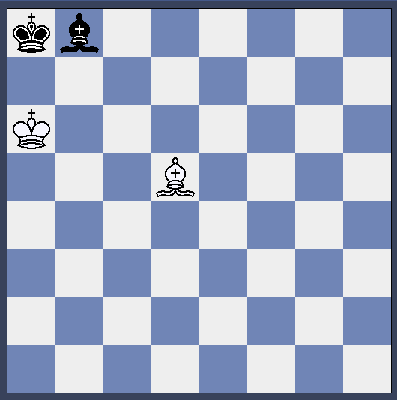
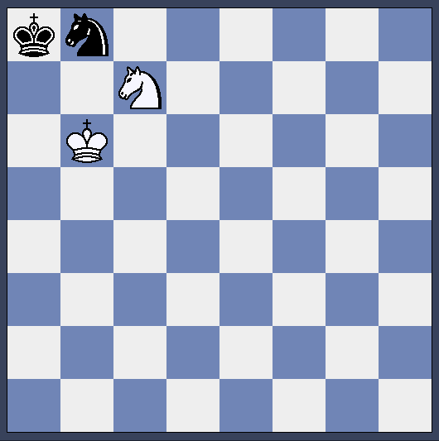
Drawn Position
If a mate can be created, no matter how unlikely, then it is not an automatic draw.

Slide 13
Other ways to draw
Draw by Repetition
50 move rule (75 Move rule)
(In both of these only the person to move can claim)
Agreement

Slide 14
Repetition
The same position must occur for a third time with the same person to move. These positions can occur at any time during the game – they do not have to be in sequence.
The position is NOT the same if an en passant capture is possible on the first occasion or the right to castle has been lost between occurrences.
If a player wishes to repeat the position and claim a draw he must write down his next move. He must not play it.

Slide 15
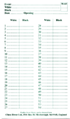
Repetition
Careful – a look at the scoresheet may not be good enough to confirm this. Some players do not indicate a capture eg Bxg3 is written as Bg3

Slide 16
COMPETITION RULES
Article 6: The chessclock
Article 7: Irregularities
Article 8: The recording of the moves
Article 9: The drawn game
Article 10: Points
Article 11: The conduct of the players
Article 12: The role of the Arbiter

Slide 17
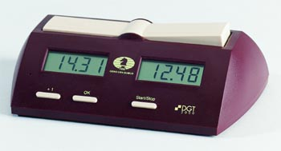
The chessclock
The chessclock is the device used for timing a game.
The clock is one face – half of a chessclock!!
In tournaments a move is only completed when the clock is pressed.

Slide 18
Irregularities
If an irregularity occurs then the board is reset to a position before the irregularity. (as near to when this occurred as possible.)
If the initial position was wrong the game shall be restarted unless otherwise finished
If a game starts with players having the wrong colours then if this is noticed before 10 moves have been MADE then the game is restarted. Otherwise it continues.
If pieces are displaced the player should do so on his own time. The clocks may be stopped whilst this happens and the arbiter should then deduct time from the player.

Slide 19
Irregularities
If an illegal move is completed the position immediately before shall be reset. If this cannot be done then the latest possible position prior to the irregularity shall be established. If this involved not replacing a promoted pawn then the pawn must become a queen.
A second illegal move by the same player loses the game unless his opponent cannot mate when the game is drawn. (This applies in Standard, Rapid and Blitz.)

Slide 20
Illegal Moves
There are now 4 categories of illegal move.
a) The original of moving a piece to a square that it cannot legally move to.
b) Failing to complete promotion properly by starting the opponent’s clock before replacing the pawn with an appropriate piece.
c) Starting the opponent’s clock before making a move.
d) Moving with two hands.
(Note pressing the clock with the other hand is not an illegal move but is an offence.)

Slide 21
Recording of Moves
Players must record their moves in algebraic notation
Scoresheet is only used for recording moves, draw offers and matters relating to draw claims and other relevant data e.g. clock times
A player must record his previous move before making his next one
The offer of a draw must be recorded (=)
If a player is unable to record an assistant may be used.
The scoresheet must be visible to the arbiter

Slide 22
Recording of Moves
If there is an increment of at least 30 seconds a player must always record, otherwise he can stop when he has less than 5 minutes
If neither player is recording (as above) then when a flag has fallen the clock is stopped and the scoresheets are then completed (arbiter should try to keep score)
If only one player has not been recording his scoresheet must be made up on his own time after flagfall
If no scoresheet available after a time scramble the game should be reconstructed

Slide 23
Recording of Moves
At the end of the game both players should sign the scoresheets which should indicate the result. If a wrong result is signed then it shall stand unless the arbiter decides otherwise.

Slide 24
Drawn Game
Tournament rules may prevent agreed draws or draws in less than a specified number of moves
The correct procedure for offering a draw is to make the move, offer the draw, press the clock
If a draw offer is made before moving it is still a valid offer but the opponent may wait to see the move
A draw can be rejected orally, by touching a piece to move it or if the game is otherwise concluded
A draw offer cannot be withdrawn, nor should it be conditional

Slide 25
Drawn game
A player may claim a draw if the same position has occurred for the third time or he is about to play a move which will do so. The move must be written down but not played.
A player may claim a draw if the last 50 moves each have been made without a capture or pawn move or if he is about to play a move which gives 50 moves each. The move has to be written down but not played
If the claim is incorrect the opponent is given an extra 2 minutes and the player must play the move which is written down

Slide 26
Drawn game
If A player touches a piece he loses the right to claim
An arbiter should declare the game drawn if 75 moves have occurred without a pawn move or capture
An arbiter should declare the game drawn if the same position has occurred 5 times at any point in the game.
The game is drawn if neither player can get checkmate

Slide 27
Points
Normally it is one point for a win, ½ for a draw and zero for a loss
Other scoring systems are allowed if announced in advance
To encourage participation in all rounds a scoring system like this could be used
3 for a win
2 for a draw
1 for a loss
0 for a default loss

Slide 28
Points
Only ‘normal’ scores are allowed.
A score of 1 - ½ is not allowed nor is ¾ - ¼
Scores of 0 – ½ are acceptable. As is 0 – 0 (which would be given for 1 e4 draw agreed as one move has not been played by both players).

Slide 29
Conduct of players
Players should not bring the game into disrepute
Players should not leave the playing venue without getting the arbiter’s permission
The player having the move is not allowed to leave the playing area without arbiter approval
Players must not use notes, sources of information or analyse
Players must not have mobile phones

Slide 30
Mobiles
Mobile phones etc are banned unless a tournament specifies otherwise.
Even then phones must be off and stored in a bag.
Many players and spectators do not understand that a phone in silent or aircraft mode is not off.

Slide 31
Conduct of players
Players who have finished their games are spectators
Players should not distract their opponents
Persistent refusal to comply with the Laws shall be penalised with the loss of the game
Players may ask arbiters to explain points of law
Players normally have the right to appeal an arbiter’s decision

Slide 32
Role of Arbiter
This will be covered in more detail in the section on Duties of an Arbiter.
Penalties available to an arbiter
Warning
Increase opponent’s time
Reduce time of offender
Reduce points scored by offender
Fine
Expulsion from tournament or a number of rounds

Slide 33
Appendix A - Rapidplay
A Rapidplay Game is more than 10 but less than 60 minutes (based on 60 moves)
Players do not need to record the moves
Normal laws may apply if one arbiter per 3 games and each game recorded (must be stated in advance and apply to the whole event]
Otherwise
After 10 moves each (a) no change to clock settings and (b) no claim can be accepted regarding incorrect set up. If king or rook positioned wrongly castling between them is not allowed

Slide 34
Appendix A - Rapidplay
The arbiter or opponent can indicate an illegal move before the opponent makes his next move. Such a game is lost by the player if it is the second offence unless the opponent cannot get checkmate.
If the arbiter doesn’t intervene or opponent doesn’t claim the game then continues with the illegal move played. It can only be corrected if both players agree.

Slide 35
Appendix A - Rapidplay
If the arbiter observes both kings in check or a pawn on the promotion square has not been exchanged he shall wait until the next move is completed. If the illegal position is still on the board he shall declare the game drawn.

Slide 36
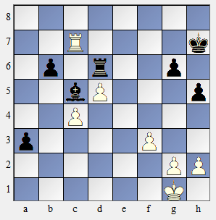
Appendix A - Rapidplay
An arbiter sees this position during a game to see Black play g6 and start White’s clock. It is an illegal position as both are in check.
The arbiter must wait until White moves.
If White plays Kf2 for example the position is still illegal and the arbiter declares the game drawn.
If White plays Kf1 the position is no longer illegal but the arbiter must still wait. If Black plays a2 then the arbiter declares that an illegal move as Black is still in check and punishes it by the Laws.

Slide 37
Appendix B - Blitz
A blitz game is 10 minutes or less
Penalties of 2 minutes in standard play are 1 minute in blitz
Normal rules apply if one arbiter per game and it is recorded.
Otherwise Rapidplay rules apply

Slide 38
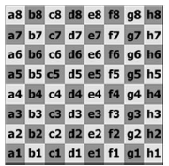
Appendix C – Algebraic Notation
Indicating captures (x) is now optional
1. e4 e5 2. Nf3 Nf6 3. d4 exd4 4. e5 Ne4 5. Qxd4 d5 6. exd6e.p. Nxd6 7. Bg5 Nc6 8. Qe3+3 Be7 9.
Nbd2 0‐0 10. 0‐0‐0 Re8 11. Kb1 (=)

Slide 39
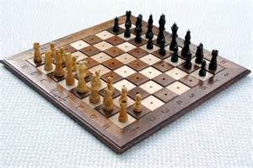
Appendix D – Rules for playing with blind and visually disabled players
Officially moves transmitted in German but a local or common language may be acceptable
Visually disabled players pieces are considered touched when removed from ‘hole’
The clock is pressed after the move is
made and announced
Both players must keep score
A slip of the tongue must be corrected
immediately and before clock is pressed

Slide 40
Appendix D – Rules for playing with blind and visually disabled players
An assistant may be used by either player to
Make either players move on opponent’s board
Announce the moves of both players
Keep visually handicapped player’s score and start opponent’s clock
Inform VH player, on request, of number of moves made and clock times
Claim game where time limit exceeded and inform arbiter of breach of touch move
Assist if game is adjourned

Slide 41
Guidelines I – Adjourned games
Adjournments are when a game is halted to continue at a later time. The player to move writes his next move down. This move will be played when the game restarts.
Adjournments may also be used if a game is halted e.g. a player takes ill
If a player seals ‘resigns’ it could be treated as bringing the game into disrepute
Conditional draw offers not allowed – treated as draw offers

Slide 42
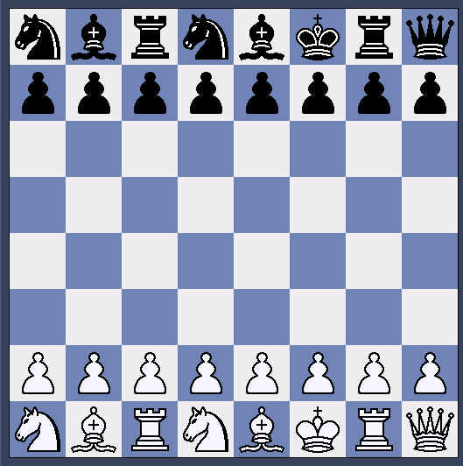
Guidelines II – Chess 960
Sometimes called Fischer or Random Chess. The pieces are placed in one of 960 different layouts.
The white king is placed between the two rooks. The bishops are placed on opposite colours.
The black pieces are placed opposite the white.

Slide 43
Guidelines III – Quickplay finishes
The final phase of the game where all moves must be completed in finite time (therefore not in incremental games).
Application of this appendix must be announced in advance.
Cannot apply to Blitz

Slide 44
Quickplay Finish – III.4
If allowed, the player on the move who has less than two minutes may request introduction of cumulative or time delay of 5 seconds per move.
This is also a draw offer which can be accepted or rejected by the opponent. Acceptance ends the game.
Otherwise, if arbiter agrees a digital clock is introduced with the 5 second increment or delay. The opponent is given an extra 2 minutes.
If the arbiter disagrees then III.5 applies.

Slide 45
Quickplay Finish – III.5
This is the old 10.2/G5 – draw claim in the last two minutes
A player, having the move, in the last two minutes of the final session may claim a draw.
He should stop the clock and summon the arbiter.
If he doesn’t stop his clock the arbiter should
He can claim that his opponent cannot win by normal means or has been making no effort to win by normal means.

Slide 46
Quickplay Finish – III.5
The arbiter shall make one of three decisions
He shall declare the game drawn if he agrees with the claim
He shall postpone his decision. In this case try to watch the game. He must make his decision later in the game or as soon as possible after a flag fall. The opponent may be given two extra minutes.
He shall reject the claim. The opponent shall be given 2 extra minutes.

Slide 47
Quickplay Finish – No Arbiter Present
When the player makes a claim as before the game ends immediately.
If he claims that the opponent cannot win by normal means he must right down final position and get it verified by opponent
If he claims the opponent is making no effort to win he must submit position and up to date scoresheet, both verified by opponent.
(The scoresheet may have been kept by another player, but not visible to the claimant.)
The claim is referred to an arbiter.

Slide 48
Glossary
Unlike the main laws it may change more often than the normal 4 year period.
E-cigarettes have been included in the ban on cigarettes.

