Slide 1


NOTATION
ECF Arbiter Seminar - Material by CAA

Slide 2
Notation
Algebraic notation should be used as given in Appendix C of the Laws of Chess.
Some older British players still use descriptive. Therefore knowing descriptive is useful but will not be taught in this course (though these notes will show the moves in descriptive for info).

Slide 3
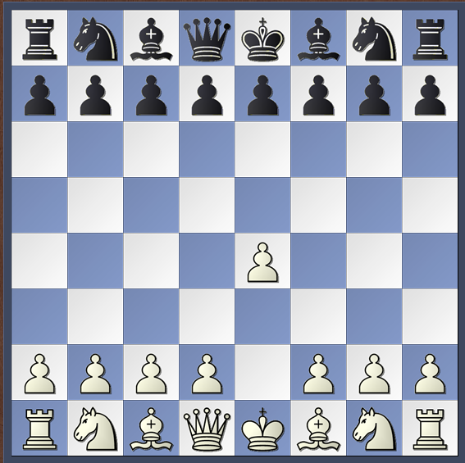
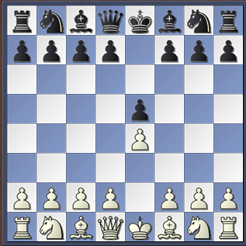
Notation
1 e4 (P-K4) 1 … e5 (P-K4)

Slide 4
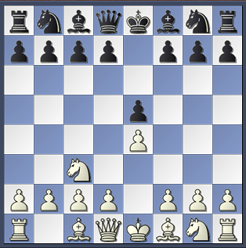
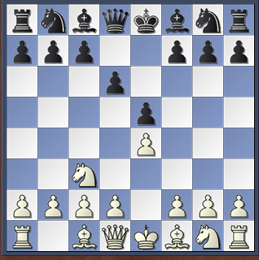
Notation
2 Nc3 (N-QB3) d6 (P-Q3)

Slide 5
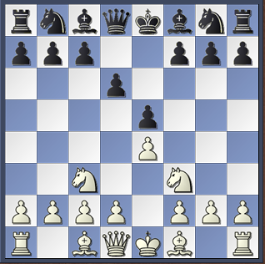
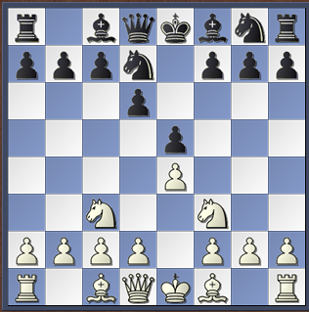
Notation
3 Nf3 (Kt-B3) Nd7 (Kt-Q2)
[Kt was used instead of N]

Slide 6
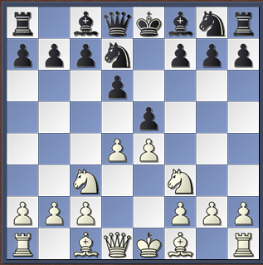
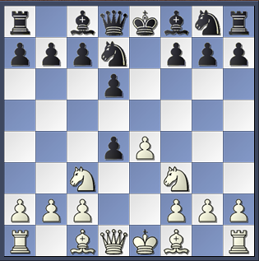
notation
4 d4 (P-Q4) exd4 (PxP)

Slide 7
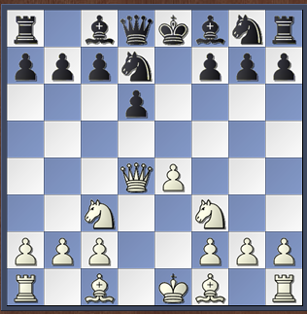
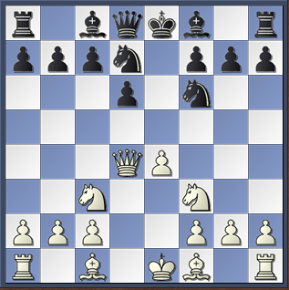
Notation
5 Qxd4 (QxP) Ngf6 (N-KB3)

Slide 8
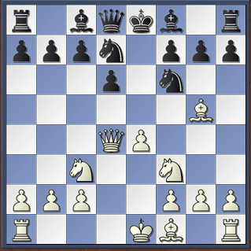
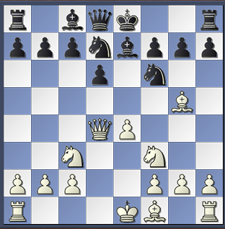
Notation
6 Bg5 (B-KN5) Be7 (B-K2)

Slide 9
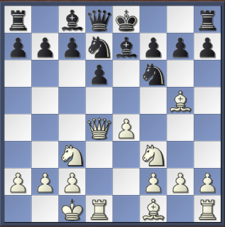
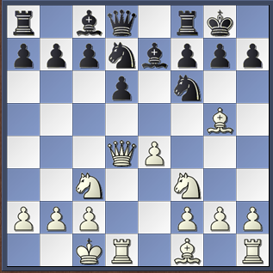
Notation
7 0-0-0 0-0 (same in descriptive)

Slide 10
Notation
The offer of a draw shall be marked as (=).
Abbreviations
0-0= castling with rook h1 or rook h8 (kingside castling) 0-0-0= castling with rook a1 or rook a8 (queenside castling)
x= captures += check
++ or #= checkmate e.p.= captures ‘en passant’
The last four are optional.
Sample game:
1.e4 e5 2. Nf3 Nf6 3. d4 exd4 4. e5 Ne4 5. Qxd4 d5 6. exd6 e.p. Nxd6 7. Bg5 Nc6 8. Qe3+ Be7 9. Nbd2 0-0 10. 0-0-0 Re8 11. Kb1 (=)
Or: 1. e4 e5 2. Nf3 Nf6 3. d4 ed4 4. e5 Ne4 5. Qd4 d5 6. ed6 Nd6 7. Bg5 Nc6 8. Qe3 Be7 9 Nbd2 0-0 10. 0-0-0 Re8 11. Kb1 (=)
Or: 1. e2e4 e7e5 2.Ng1f3 Ng8f6 3. d2d4 e5xd4 4. e4e5 Nf6e4 5. Qd1xd4 d7d5 6. e5xd6e.p. Ne4xd6 7. Bc1g5 Nb8c6 8. Qd4d3 Bf8e7 9. Nb1d2 0-0 10. 0-0-0 Rf8e8 11. Kb1 (=)

