Slide 1


Pairings

Slide 2
Pairings
Basic rules for Swiss Systems The following rules are valid for each Swiss system unless explicitly stated otherwise. The number of rounds to be played is declared beforehand Two players shall not play each other more than once Should the total number of players be (or become) odd, one player is unpaired. He receives a bye: no colour and as many points as are rewarded for a win, unless the regulations of the tournament state otherwise A player who, for whatever reason, has received any number of points without playing, shall not receive a bye. In general, players are paired to others with the same score

Slide 3
Pairings
For each player the difference of the number of black and the number of white games shall not be greater than 2 or less than –2. Each system may have exceptions to this rule in the last round of a tournament. No player will receive the same colour three times in a row under the Dutch system. Each system may have exceptions to this rule in the last round of a tournament. In general, a player is given a colour as many times as he is given the other colour. In general, a player is given the colour other than that he was given the previous round. The pairing rules must be transparent enough that the person who is in charge for the pairing can explain them.

Slide 4
Pairings
The Dutch System is the most commonly used Swiss pairing system. The current version appears to some to be written more for computer programmers than for arbiters. The CAA system which is also common in Britain is designed for manual pairings. Both systems have good and bad points. To pass this course some knowledge of doing pairings manually is required but complex examples will not be covered.

Slide 5
Pairing
The basic principles of doing a Swiss draw are:
Players do not meet more than once
Players meet opponents with the same score or as near as possible
Players have equal numbers of Whites and Blacks if possible (this means that colours tend to alternate)
If you have an odd number of players then the bye comes from the lowest score group.

Slide 6
Pairing
In this course we will try to keep doing pairings to be as simple as possible.
The full rulesfor the Dutch System are available in the FIDE Handbook. See the following sections:
C.04.1 Basic rules for Swiss Systems
C.04.2 General handling rules for Swiss Tournaments
C.04.3 FIDE (Dutch) System
The CAA system is given in its booklet from the CAA site

Slide 7
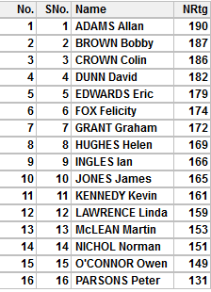
Round 1
The players are arranged in order of grade, highest first.
The first round sees the top half play the bottom half. So in this case players 1 to 8 play 9 to 16 in order.
The colour of the top half players should alternate.
It is usual to decide the colour of the first seed by lot, though some competitions will specify how this is done.
Here the top seed has been given white so the round 1 pairing will be -
1v9, 10v2, 3v11, 12v4, 5v13, 14v6, 7v15, 16v8

Slide 8
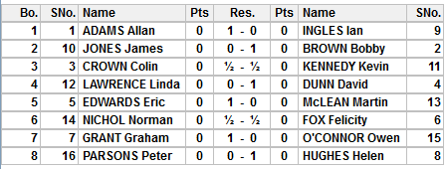
Round 1
The results of round 1 are as shown. These should be entered carefully.

Slide 9
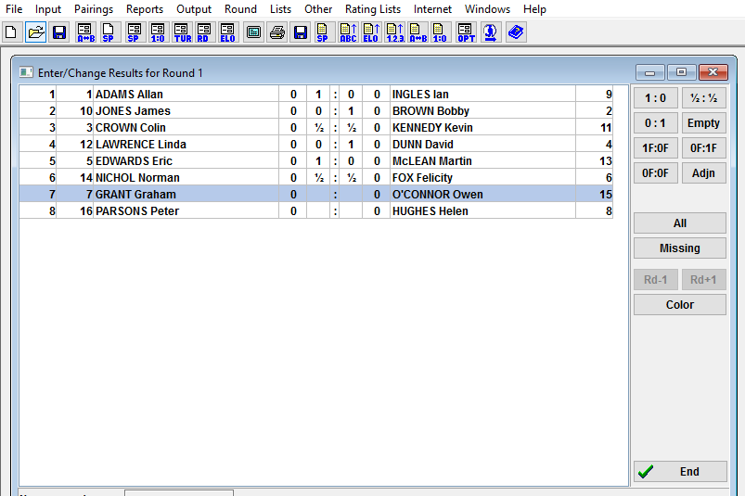
Entering results into a computer

Slide 10
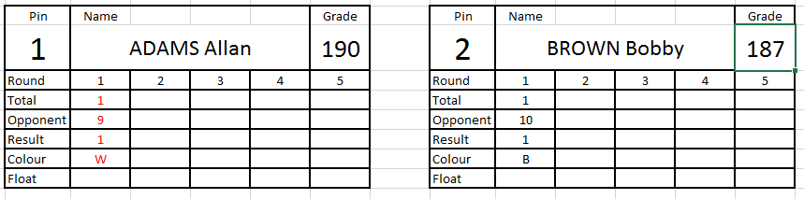
Entering results onto a card (manual)
When filling out card it is usual to use red for white and blue or black for black. Green is used for byes which are regarded as colourless.

Slide 11
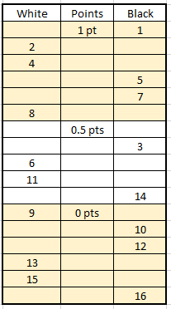
Round 2
The players can be arranged by score and colour sought.
Colours are balanced and alternated when possible.
Sorting them gives the table opposite.
For each score group we try to pair the top half against the bottom.

Slide 12
Round 2 – 1 point group
In this group we have three white seekers and three black seekers so there is no need for any colour changes.
1, 2 and 4 are top half 5,7 and 8 are bottom half.
The ideal pairing is 1v5, 2v7 and 4v8 but the colours are wrong for that.
8 is the only bottom half player due white so that plays 1. The other cards can then be paired top v bottom with little problem, allowing 2 to play 5 and 4 to play 7.
8v1, 2v5 and 4v7

Slide 13
Round 2 – half point group
We have 2 white seekers and two black seekers
so it looks straightforward with 11v3 and 6v14.
Unfortunately both of those pairings occurred
in round 1 so cannot be repeated.
We don’t need any colour changes so we are left with 6v3 and 11v14.

Slide 14
Round 2 – 0 point group
Following the same steps as with the 1 point
group gives 9v16, 13v10 and 15v12.

Slide 15
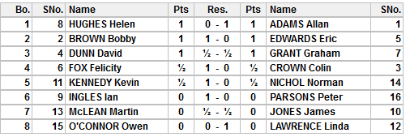
Round 2 - Results

Slide 16
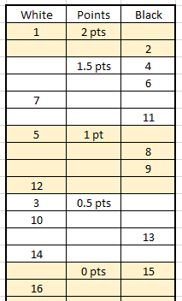
Round 3
Sorting as shown
On the top score group we have 1v2
Looking at the 1.5 points we see we have 1 white seeker and 3 black seekers so we will need to do 1 colour change.
Looking at 4, 6 and 11 shows identical colour sequences so there is no obvious candidate to change colour.
4 and 7 have already played. This leaves 11 to play 4 if 7 can play 6.
They can play. 4 is the higher graded so keeps the colour due.
The pairing is therefore 11v4 and 7v6.

Slide 17
Round 3
The one point group falls into place giving 5v9 and 12v8
We have to do a colour change in the half point score group.
Ideally we would want 3v13 and 10v14. This is possible. 14 gets the extra black as 10 keeps colour preference as the higher graded.
On zero points 16v15 is possible.

Slide 18
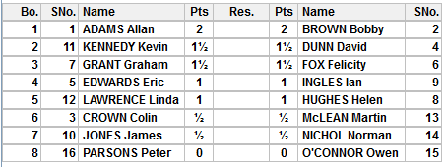
Round 3

Slide 19
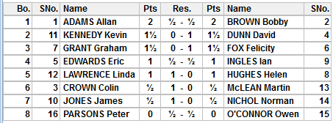
Round 3 Results

Slide 20
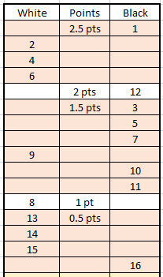
Round 4
In round 4 the Dutch and CAA systems will produce a slightly different pairing.
This is because both systems treat downfloats differently. Downfloats are where, usually because of an odd number, someone from a higher score must play in a lower scoregroup.
The Dutch system floats down the lowest graded player from the larger colour group, working up if necessary. The CAA system starts from the median and works down.
In the Dutch system a player will not float in the same direction for a further two rounds. This is only one round in the CAA version. In both, the opponent is the highest rated suitable.

Slide 21
Round 4 – Dutch System
The top score group is done in the usual way.
We need a colour swap from 2,4 or 6. There is no difference in colour history. So we get 4v1 and 2v6. (Check they haven’t played!)
12 must float down. We now have six black seekers and one white seeker. We will have another downfloat to even the numbers and two colour changes.
11 seems to be the obvious downfloat. 9 is the wrong colour even if it was a lower number.

Slide 22
Round 4 – Dutch System
12 should play the highest possible opponent. 9 is the right colour but we need two colour changes to the white side. Some arbiters would take 7 and 10 across in which case 7 would float up to play 12. This is not correct. It is better to bring 3 across and float up.
It is not always the lowest graded players who change colours. It is the ones who best suit top v bottom in order.
Notice also that 3 gets white. 12 has a higher score. This is more important than grade when deciding colour.

Slide 23
Round 4 – Dutch System
We now want 9 to play 5 but they have already met. So we try 10 v 5. This leaves 9 v 7. Recheck that the players have not met before.
8v11 is a good pairing.
The bottom group can then be paired as 13v15 and 14v16.

Slide 24
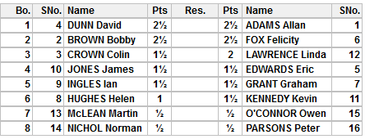
Round 4 – Dutch System

Slide 25
Round 4 – CAA System
The first pairings are actually the same.
The difference comes in the 1.5 score group.
3v12 is still a correct pairing. But first … The difference is in the downfloat. We have 6 players in the scoregroup, 3 above the median and 3 below. 10 is nearest the median from the largest colour group so that is our downfloat.
This gives 11 to play 5 (remember 9v5 has already played) and 9v7. Because 11 has already had 2 whites in a row 5 changes to white giving 5v11.
8v10 is the next pairing.
The rest is the same.

Slide 26
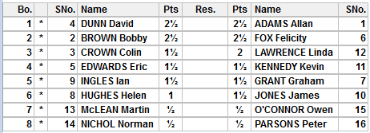
Round 4 – CAA System

Slide 27
FIDE (Dutch) v CAA
In general the FIDE (Dutch) System is simpler to employ than the CAA one but the instructions are more difficult to understand.
Differences
Dutch | CAA
The lowest rated downfloats Top Half v Bottom half is paired and then colours decided Three of the same colour in a row is only allowed in the last round. A score group would be ‘broken’ to prevent this. For example, there are only two players in the group both have had BBWW v BBWW – both players would float as neither can have a third white unless last round. | The median or below downfloats ‘Obvious’ colour changes are made before pairing carried out Three of the same colour in a row is allowed (but is less likely to happen)

Slide 28
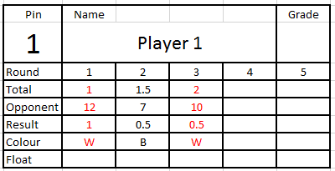
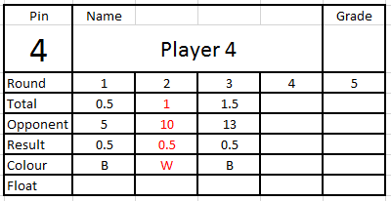
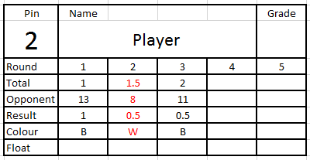
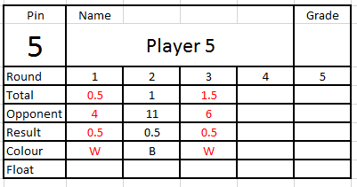


And Finally …
Pair these 6 cards

Slide 29
Looking at the 2pt group 1 & 3 want black, 2 wants white. The normal pairing would be 2v1 with 3 downfloating. But 3 has already downfloated. Therefore the pairing is 2v3 and 1 downflaots.

Slide 30
Sorting the 1½ score group shows 4 & 6 want white and 5 wants black.
4 floats up to play 1
But 6 has already played 5.
So we try to upfloat 6 instead. We now see 4 has also played 5!!!
Sometimes changing the downfloat can help … but not here.
The only solution is to float up 5.

Slide 31
5 gets the extra white as the lower rated.
We now have to decide who gets white between 4 and 6.
4 is the higher rated so should keep the colour sequence and therefore gets white.
This gives –
2v3, 5v1 and 4v6

