Slide 1


Recording a Position
ECF Arbiter Seminar - Material by CAA

Slide 2
Recording a Position
Arbiters often have to record a position on the board.
This can be necessary if the game is adjourned (now rare but can happen because of illness during a congress). It is more likely to be necessary when a draw claim is made which has to be checked on another board away from the one in use for the game.
There are two common ways of recording the position.
One is to use a diagram with a pre-printed board ‘blank’ and the other is to use Forsyth notation

Slide 3
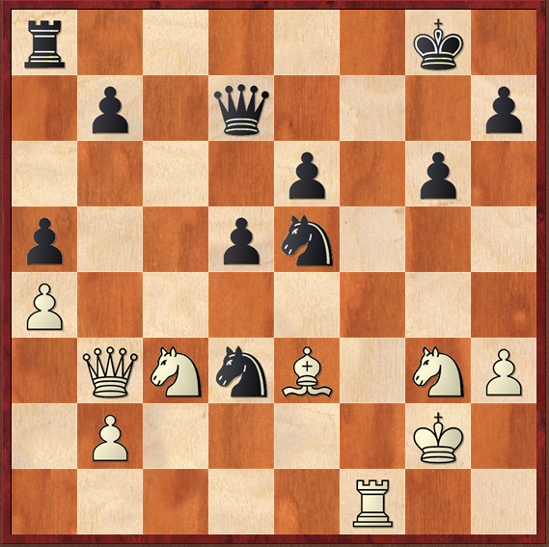
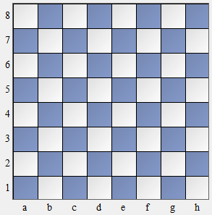
Using a Diagram
The position on the board is reached.
This can be transferred to the blank diagram by using upper case letters for the white pieces (K,Q,B,N,R,P) and lower case (k,q,b,n,r,p) or circled pieces (eg ®,➔) for the black.
Note that the initial letter of the piece is used except Knights are N or n.
r k
p q p
p p
p p n
P
Q N n B N P
P K
R

Slide 4
Forsyth Notation
In Forsyth Notation the position would be given as
r5k1/1p1q3p/p2pn3/P7/1QNnB1NP/1P4K1/5R2
This means, starting at the top left, we have a
black rook then 5 empty squares then a black king
and one empty square. The end of the row is
indicated by a slash/.
The initial position could be recorded as
rnbqkbnr/pppppppp/8/8/8/8/PPPPPPPP/RNBQKBNR
or rnbqkbnr/pppppppp/32/PPPPPPPP/RNBQKBNR.
Multiple rows with no pieces can be combined.
When writing down the position always start from the
a8 square.

