Slide 1
Tie-Breaks

Slide 2

Tie Breaks
The only totally satisfactory tie break is to have a play-off under the same conditions.
This is seldom possible so alternative methods have to be used if the players have to be separated.
Unplayed games, such as those caused by withdrawals, can cause major problems with tie breaks.

Slide 3
Tie Breaks
Number of Games Won
Number of Games with Black
Direct Encounter
Consider the situation where three players have tied at the top. Their results against each other are considered.
Player 1 1-0 Player 2; Player 2 ½-½ Player 3; Player 1 ½-½ Player 3.
Drawing up a table gives Player 1 as the winner
Tie Break using the players own results.
Name | Player 1 | Player 2 | Player 3 | Total
Player 1 | ********** | 1 | ½ | 1½
Player 2 | 0 | ********** | ½ | ½
Player 3 | ½ | ½ | ********** | 1

Slide 4
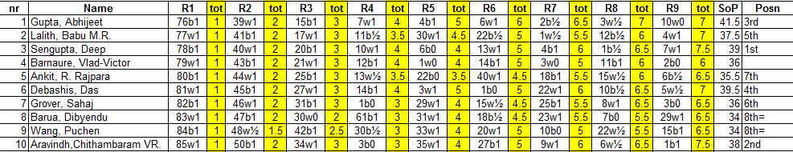
Tie Breaks
Sum of Progressive Scores
This is calculated by adding the players total score for each round.
For Gupta in the table below his totals at the end of each round are:
These are added together to give his Sum of Progressive Scores.
In this case it is 41½.
Rd1 | Rd2 | Rd3 | Rd4 | Rd5 | Rd6 | Rd7 | Rd8 | Rd9 | Total
1 | 2 | 3 | 4 | 5 | 6 | 6½ | 7 | 7 | 41½
Tie Break using the players own results.

Slide 5
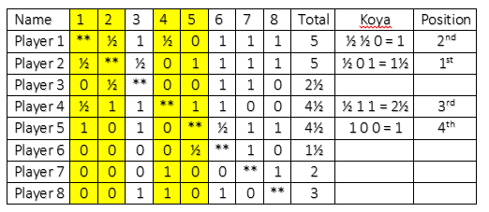
Tie Breaks
Koya (for Round Robins)
The number of points achieved against opponents with at least 50% scores.
The above example shows the result of using Koya.
Tie Break using the players own results.

Slide 6
Tie Breaks
Team events are usually decided on either match points or on game points.
The alternative can be used as a tie break method.
Tie Break Systems using Teams results
Team | A | B | C | D | Game Points | Match Points
A | **** | 2½ -1½ | 2½ -1½ | 2½ -1½ | 7½ | 6
B | 1½-2½ | **** | 3-1 | 4-0 | 8½ | 4
C | 1½-2½ | 1-3 | **** | 2-2 | 4½ | 1
D | 1½-2½ | 0-4 | 2-2 | **** | 3½ | 1

Slide 7
Tie Breaks
A match between two teams can be decided by board count or board elimination.
Board Count
Glasgow has won on boards 1 and 4. Add together = 5
Durban has won on boards 2 and 6. Gives total of 8
Glasgow has the lower total so wins.
Tie Break Systems using Teams results
Glasgow | Result | Durban
A Green | 1-0 | A Dunn
B Gray | 0-1 | B Downs
C Gordon | ½-½ | C Dover
D Gow | 1-0 | D Donald
E Glass | ½-½ | E Dixon
F Greig | 0-1 | F Denver
 | 3-3

Slide 8
Tie Breaks
Board Elimination
The bottom board is eliminated (work up if drawn).
The score now is Glasgow 3-2 Durban.
Both methods fail if all games are drawn.
Glasgow | Result | Durban
A Green | 1-0 | A Dunn
B Gray | 0-1 | B Downs
C Gordon | ½-½ | C Dover
D Gow | 1-0 | D Donald
E Glass | ½-½ | E Dixon
F Greig | 0-1 | F Denver
 | 3-3
Tie Break Systems using Teams results

Slide 9
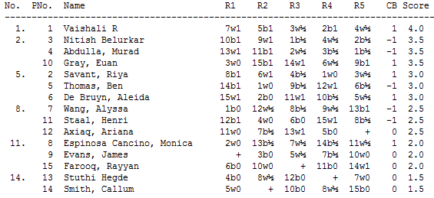
Tie Breaks
Bucholtz (Sum of Opponents’ Scores)
Consider the Bucholtz score of Murad Abdulla.
He played pins 13, 11 2, 3 and 1 who scored:
There can be variations such as Cut 1 where the lowest score is removed for each player or Median Bucholtz where the highest and lowest are removed.
Tie Break Systems using results of opponents
Pin | 1 | 2 | 3 | 11 | 13 | Total
Score | 4 | 3 | 3½ | 2½ | 1½ | 14½

Slide 10
Tie Breaks
Sonneborne-Berger (Individual)
Here the total score of defeated opponents is used and one half that of opponents drawn with. Nothing is given for a loss.
Consider Riya Savant:
Tie Break Systems using results of opponents
Opp Pin | 1 | 3 | 4 | 6 | 8 | Total
sco/res | 4 x 0 | 3½ x ½ | 3½ x ½ | 3 x 1 | 2 x 1
points | 0 | 1¾ | 1¾ | 3 | 2 | 8½

Slide 11
Tie Breaks
Sonneborn-Berger (Team events)
The S-B score for teams is the total score made by the opposing team multiplied by the score made against that team.
Team A on Game Points has a S-B of
v Team B 5x24, v Team C 4x21, v Team D 6x19, v Team E 4x17 and v Team F 5x15= 120+84+114+68+75=461
Team A on Match Points has a S-B of
2x8+1x6+2x3+1x3+2x2=16+6+6+3+4=35
Team | A | B | C | D | E | F | Game Pt | Match Pt
A | XXX | 5-3 | 4-4 | 6-2 | 4-4 | 5-3 | 24 | 8
B | 3-5 | XXX | 6-2 | 5-3 | 5-3 | 5-3 | 24 | 8
C | 4-4 | 2-6 | XXX | 4-4 | 6-2 | 5-3 | 21 | 6
D | 2-6 | 3-5 | 4-4 | XXX | 3-5 | 7-1 | 19 | 3
E | 4-4 | 3-5 | 2-6 | 5-3 | XXX | 3-5 | 17 | 3
F | 3-5 | 3-5 | 3-5 | 1-7 | 5-3 | XXX | 15 | 2
Team | A | B | C | D | E | F | Game Pt | Match Pt
A | XX | 2 | 1 | 2 | 1 | 2 | 24 | 8
B | 0 | XX | 2 | 2 | 2 | 2 | 24 | 8
C | 1 | 0 | XX | 1 | 2 | 2 | 21 | 6
D | 0 | 0 | 1 | XX | 0 | 2 | 19 | 3
E | 1 | 0 | 0 | 2 | XX | 0 | 17 | 3
F | 0 | 0 | 0 | 0 | 2 | XX | 15 | 2
Tie Break Systems using ratings

Slide 12
Tie Breaks
Average Rating (Mean Rating)
The average rating of opponents can be used to break ties.
Unrated opponents should be given the rating floor – currently 1000.
Byes or defaults do not count in this calculation.
Tie Break Systems using Rating
Name | Rating
Adams | Unrated | 1000
Brown | 2003 | 2003
Collins | 1985 | 1985
Docherty | 2034 | 2034
Edwards | 1834 | 1834
Fox | 1956 | 1956
Average |  | 1802

Slide 13
Tie Breaks
Tournament Performance
This is based on games against rated players. The average of the opposition is calculated. The percentage score against this opposition is calculated. These are then used to calculate the Tournament Performance Rating (TPR).
Consider:
A player scores 7/11
Including a win
Against an unrated
opponent.
The average rating
Of his other
opponents is
1987 (R_{a}).
What is his TPR?
He scored 6/10 from
his games or .60.
This gives a d_{p} of 72.
Therefore his
TPR =1987+72
= 2059
p | d_{p} | p | d_{p} | p | d_{p} | p | d_{p} | p | d_{p} | p | d_{p}
1.0 | 800 | .83 | 273 | .66 | 117 | .49 | -7 | .32 | -133 | .15 | -296
.99 | 677 | .82 | 262 | ,65 | 110 | .48 | -14 | .31 | -141 | .14 | -309
.98 | 589 | .81 | 251 | .64 | 102 | .47 | -21 | .30 | -149 | .13 | -322
.97 | 538 | .80 | 240 | .63 | 95 | .46 | -29 | .29 | -158 | .12 | -336
.96 | 501 | .79 | 230 | .62 | 87 | .45 | -36 | .28 | -166 | .11 | -351
.95 | 470 | .78 | 220 | .61 | 80 | .44 | -43 | .27 | -175 | .10 | -366
.94 | 444 | .77 | 211 | .60 | 72 | .43 | -50 | .26 | -184 | .09 | -383
.93 | 422 | .76 | 202 | .59 | 65 | .42 | -57 | .25 | -193 | .08 | -401
.92 | 401 | .75 | 193 | .58 | 57 | .41 | -65 | .24 | -202 | .07 | -422
.91 | 383 | .74 | 184 | .57 | 50 | .40 | -72 | .23 | -211 | .06 | -444
.90 | 366 | .73 | 175 | .56 | 43 | .39 | -80 | .22 | -220 | .05 | -470
.89 | 351 | .72 | 166 | .55 | 36 | .38 | -87 | .21 | -230 | .04 | -501
.88 | 336 | .71 | 158 | ,54 | 29 | .37 | -95 | .20 | -240 | .03 | -538
.87 | 322 | .70 | 149 | .53 | 21 | .36 | -102 | .19 | -251 | .02 | -589
.86 | 309 | .69 | 141 | .53 | 14 | .35 | -110 | .18 | -262 | .01 | -677
.85 | 296 | .68 | 133 | .51 | 7 | .34 | -117 | .17 | -273 | .00 | -800
.84 | 284 | ,67 | 125 | .50 | 0 | .33 | -125 | .16 | -284
Tie Break Systems using Rating

Slide 14
Tie Breaks
For Rating Prizes only
A method of tie break is to award the prize to the lowest rated player in the group.
In some circumstances this would be seen to be an unfair method of deciding the tie break, e.g. to decide first place, but for a prize such as the rating prize this may be a perfectly acceptable way of resolving the tie.
Tie Break Systems using Rating

Slide 15
Tie Breaks
Play-offs
These can take various forms.
Usually a series of games played at increasingly fast time controls until you have a winner. E.g. 4 Standard play games, followed by 4 Rapidplay games if needed, followed by 4 Blitz games if needed. Normally each section will have an even number of games giving equal numbers of white and blacks.
Finally you may have an Armageddon game to decide. Here Black will have less time than White but will have the advantage of a draw.
This will often be 6 minutes v 5 mins (more recently 5 v 4 with 3 second increments from move 60). Usually lots are drawn for colours but a variation is to have the players bid for Black’s time (with a maximum of say 5 minutes if White has 6). The lowest bid wins.
Tie Break Systems using Play-offs

