Slide 1
Tournaments
Different types of Tournament

Slide 2
Tournaments
Round Robin
Knock-out
Matches
Scheveningen System
Swiss System

Slide 3
Tournaments
Round Robin
Used for some of the top events.
Also called All-play-all or American.
The lowest half of the draw may get an extra white.
If you have an odd number then the highest number is the bye.
A double round robin is regarded as the best system if time permits.
 | 1 | 2 | 3 | 4 | 5 | 6 | 7 | 8 | 9
1 | 1-10 | 10-6 | 2-10 | 10-7 | 3-10 | 10-8 | 4-10 | 10-9 | 5-10
2 | 2-9 | 7-5 | 3-1 | 8-6 | 4-2 | 9-7 | 5-3 | 1-8 | 6-4
3 | 3-8 | 8-4 | 4-9 | 9-5 | 5-1 | 1-6 | 6-2 | 2-7 | 7-3
4 | 4-7 | 9-3 | 5-8 | 1-4 | 6-9 | 2-5 | 7-1 | 3-6 | 8-2
5 | 5-6 | 1-2 | 6-7 | 2-3 | 7-8 | 3-4 | 8-9 | 4-5 | 9-1

Slide 4
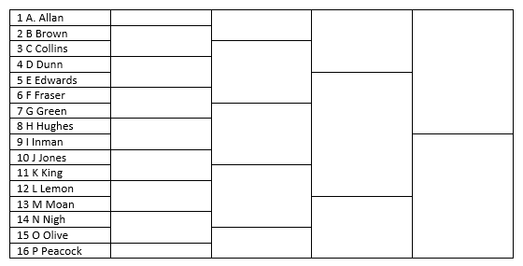
Tournaments
Knock-out
Not too popular a format as half the competitors are eliminated each round.
Sometimes there is a consolation event for the first round losers.
Possibly more common for team events than for individual events outside of a club setting.

Slide 5
Tournaments
Matches
Used to decide the World Championship.
Used to be a common type of event particularly in the 19th century but now much less so.

Slide 6
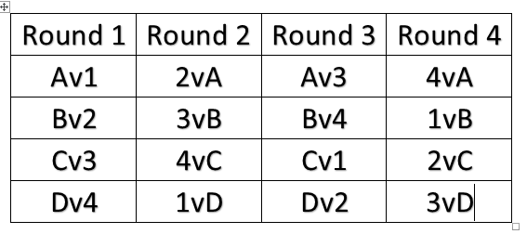
Tournaments
Scheveningen
A system which pairs two teams together so that each member of one team plays all of the members of the other team.
Due to a number of this type of event having a ‘dubious nature’ they are no longer automatically accepted by FIDE for title norms.

Slide 7
Tournaments
Swiss Systems
FIDE (Dutch)
Lim
Dubov
Accelerated Swiss
Others (e.g. CAA)
The FIDE (Dutch) system is the one that most programs follow (or attempt to). This is the system that we will study in some detail.
Lim is a similar system but has some differences in its rules. The Dutch system pairs top to bottom, Lim works towards the middle from both ends.
Dubov tries to equalise the strength of opponents of the White players. The White seeker with the highest performance is paired against the lowest rated Black seeker.
Acceleration is carried out for one of two reasons – to reduce number of mismatches in first round or to enhance norm chances. In simple terms when doing the first round pairing you assume a round 0 has taken place.

Slide 8
Tournaments – Playing Hall
Well lit
Well ventilated
Adequate space – 4.5 sq metres in top tournament 2.5 in others. 2,5 metres between rows
Tables should have sufficient room for board, set, clock, scoresheet and refreshments. A height of 74 cm recommended.
Chairs should be comfortable and appropriate height for table
Conditions for both players should be identical

Slide 9
Tournaments
Swiss Systems
These have the advantage of letting everyone play in every round but still achieving a winner in a relatively short number of rounds.
A 32 player tournament would require only 5 rounds to ensure only one player has a 100% score.
Main principles
Don’t play the same opponent more than once.
Play someone on the same score or as near as possible
Attempt to alternate colours

Slide 10
Tournaments - Equipment
Clocks dealt with in their own section
Pieces made of wood or plastic (or similar)
King’s height about 9.5cm – base should be 40-50% of height, other pieces proportionate
The weight of the pieces should be suitable for comfortable lifting and stability.
Staunton pattern recommended for FIDE events
Dark pieces should be black or brown (or dark shades of these colours). The light pieces should be white, cream or other light colour

Slide 11
Tournaments - Equipment
Boards should be wood or rigid plastic or card. Stone is also permitted.
The squares should be of contrasting colours Combinations of colours such as brown, green or light tan and white etc.

Slide 12
Tournaments – Disputes and Appeals
When there is a dispute the Chief Arbiter or Chief Organiser should try to resolve the situation.
In all FIDE rated events there should be an Appeals Committee (AC). This can be appointed or elected and should be done before the start of play.
Recommended composition is a Chair, two members and two reserve members (ideally from different federations).
No member of the AC should have previously been involved in the dispute.
The AC should have an odd number.
No-one on the AC should be under 21.

Slide 13
Tournaments – Disputes and Appeals
Player may appeal against decision made by Arbiter or Organiser
The appeal should be accompanied by appropriate fee
The appeal should be in writing
The appeal should be made within a specified time period
(Fee and Time Period set in advance)
Decision of AC shall be final
Fee returned if appeal is successful
Fee may be returned if an unsuccessful appeal is considered reasonable.

